Slide 1
How to design and build lightweight and compact telescopes
Alan Scott

Slide 2
Deep Space Trill
12” truss dob reflector that fits in a suitcase

Slide 3
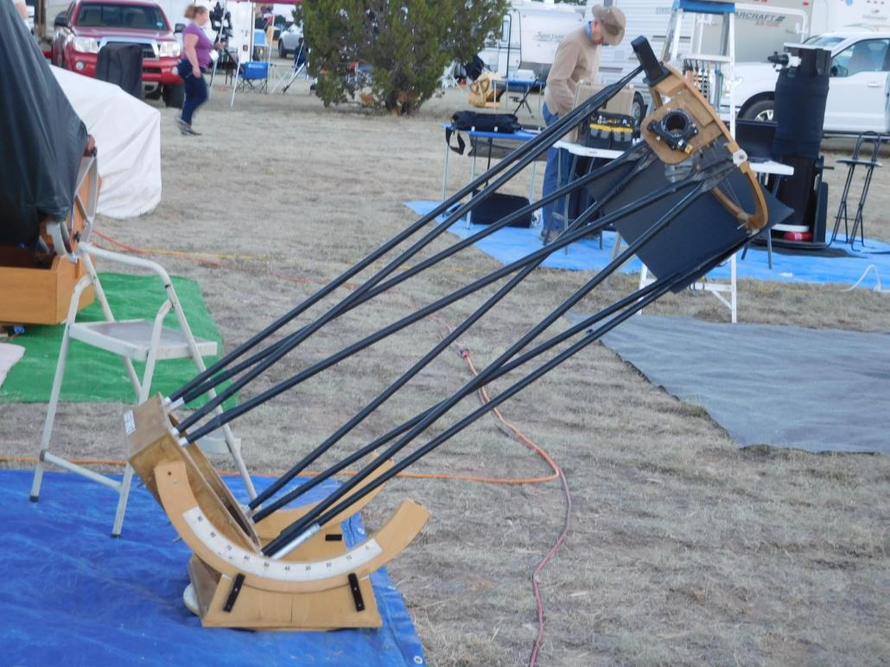
Deep Space 4 (.4m, 16”)

Slide 4
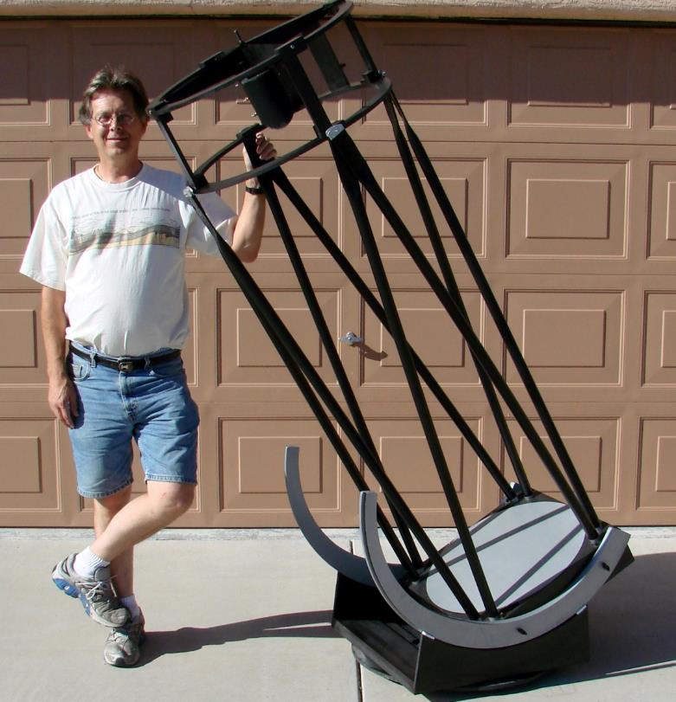
Deep Space 5 (.5m, 20”)

Slide 5
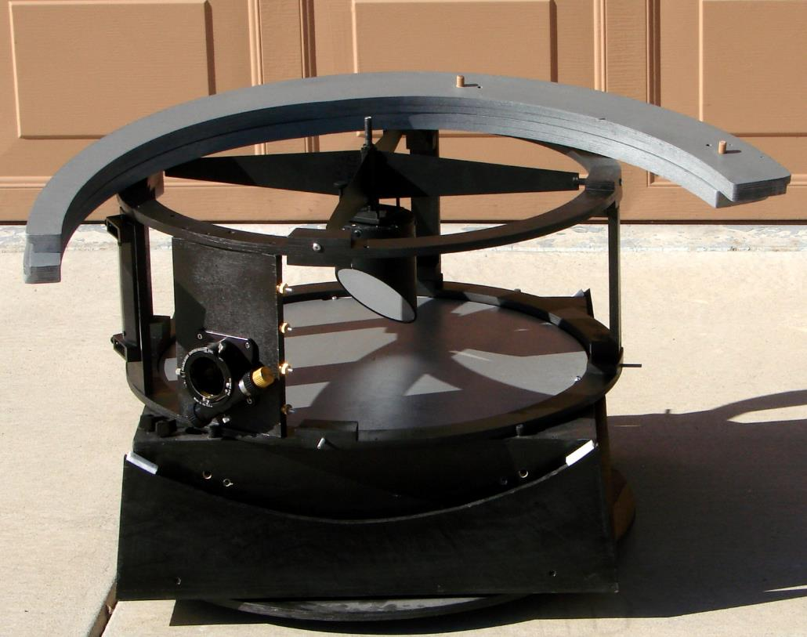
Deep Space 5

Slide 6
Deep Space Telescopes
Websites
https://user.xmission.com/~alanne/DS5/DS5Main.html
https://user.xmission.com/~alanne/DS4/DS4Main.html
https://user.xmission.com/~alanne/DStr/DS-tr-Main.html

Slide 7
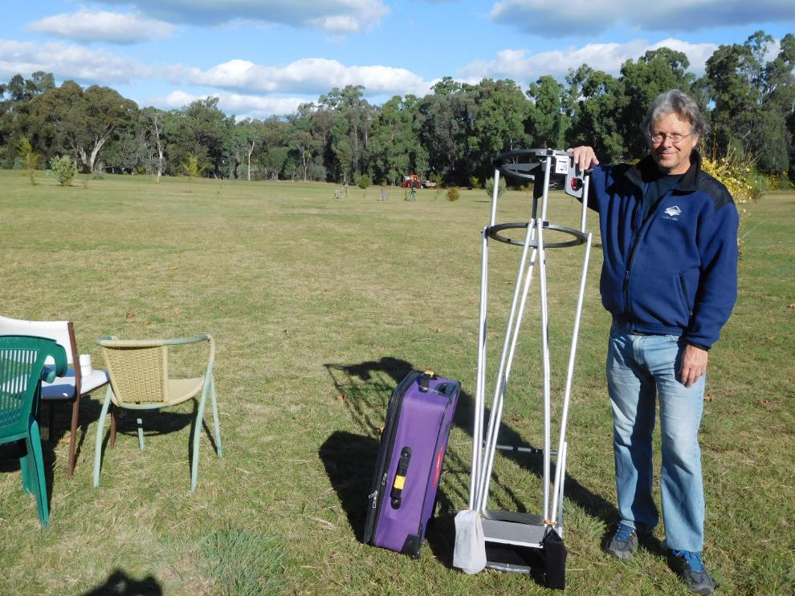
Deep Space Trill (.3m, 12”)

Slide 8
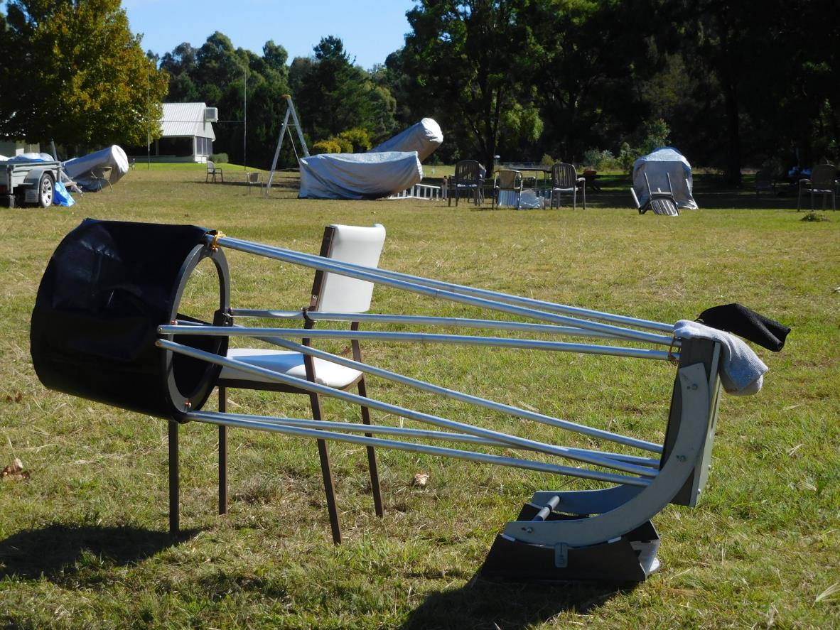

Slide 9
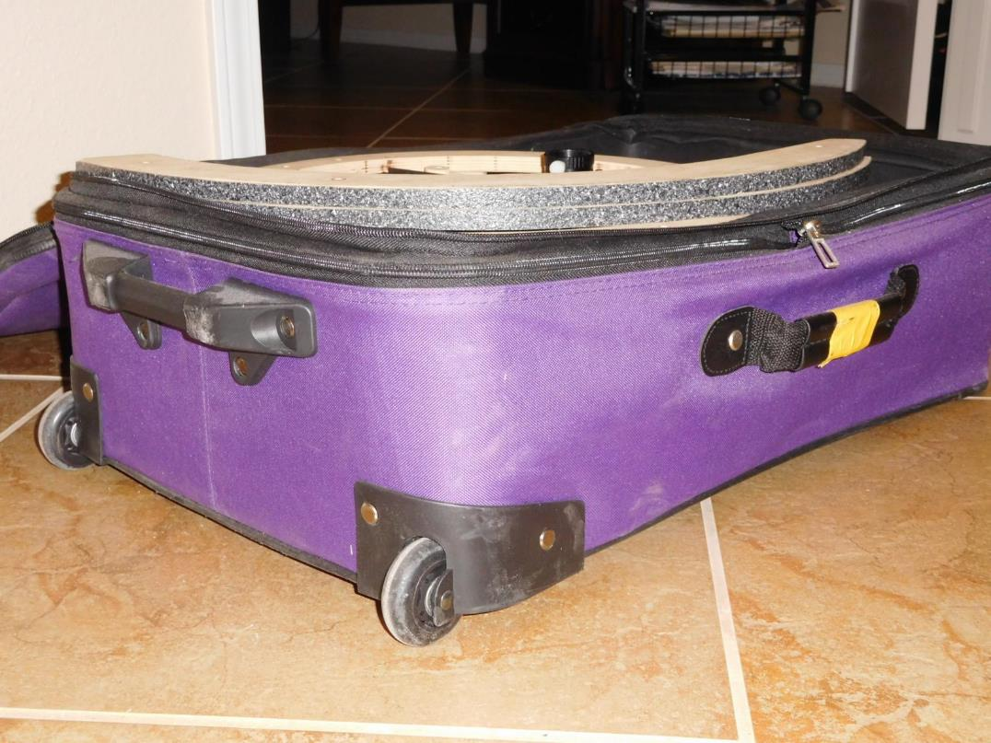
DS Trill in a suitcase

Slide 10
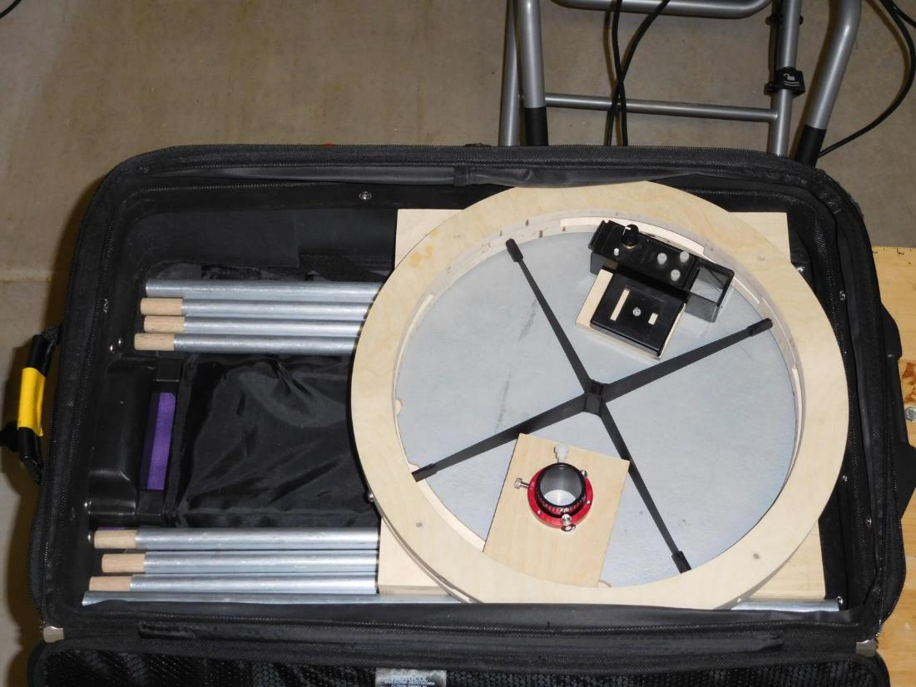
DS Trill

Slide 11
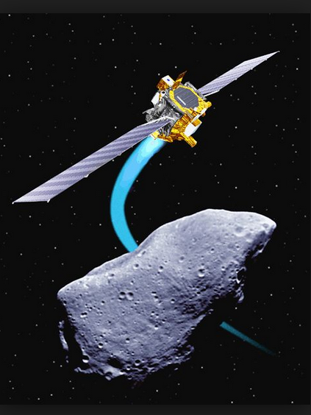
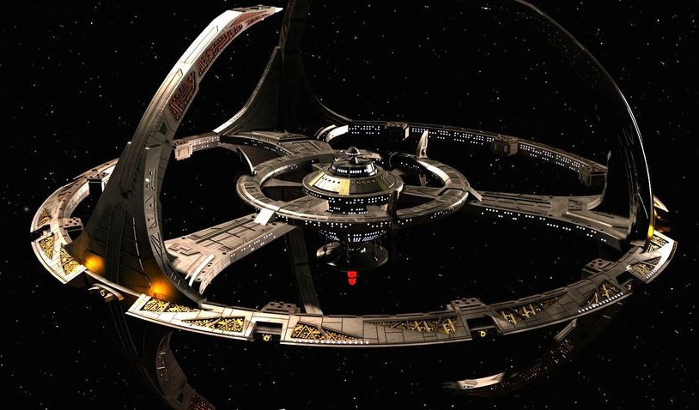
Deep Space

Slide 12
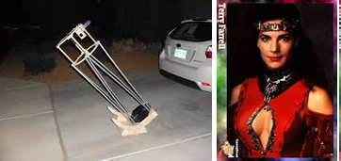
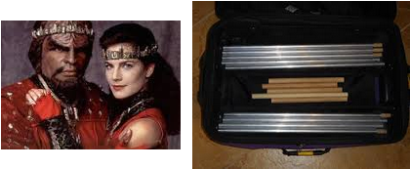
Trill

Slide 13
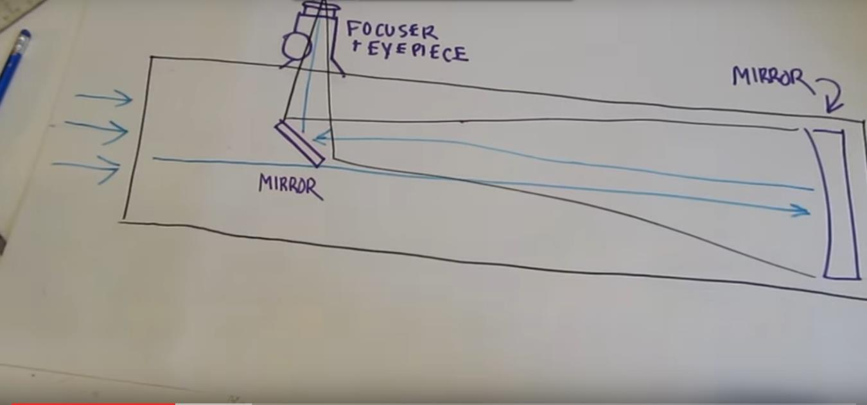
What is a reflecting telescope?

Slide 14
Designing and building a Telescope
Choose the correct goals
Order the goals
Work big picture before details
Design on paper first
Prototype the hard stuff
Order of design and build is mirror box, upper cage, trusses, bearings , rocker box and ground board

Slide 16
Good Goals
Target objects (planets, double stars, clusters)
Optics size and type (light gathering)
Eyepiece height (do I need a ladder?)
Weight and size in transport (how to move it?)
Setup / teardown time (at 3am)
Total system cost (telescope, eyepieces, transport)
Obsession classics – designed with great goals

Slide 17
Bad Goals
Wire spider (DS-4)
Single ring upper cage (DS-4)
Ultra compact that is too heavy to lift (Obsession 18” UC is 72 lbs), and needs wheel barrow handles and ramps.
Ultra light that is flimsy, needs a ladder or is not compact

Slide 18

Why build a travel telescope - OzSky

Slide 19
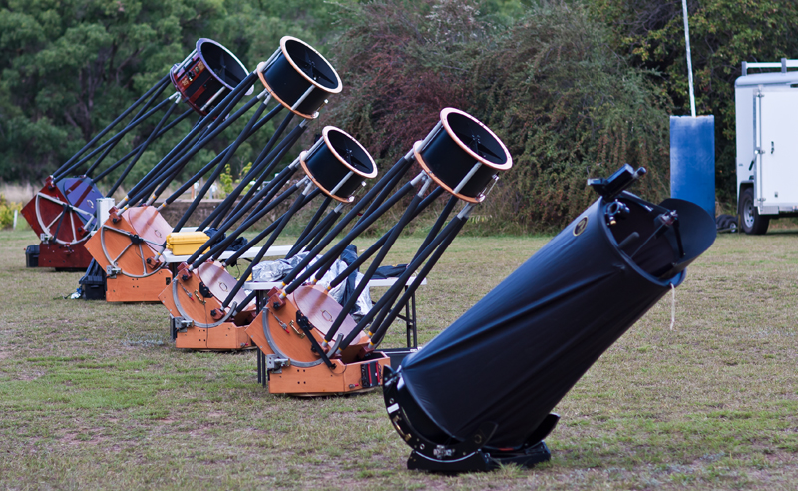

Slide 20
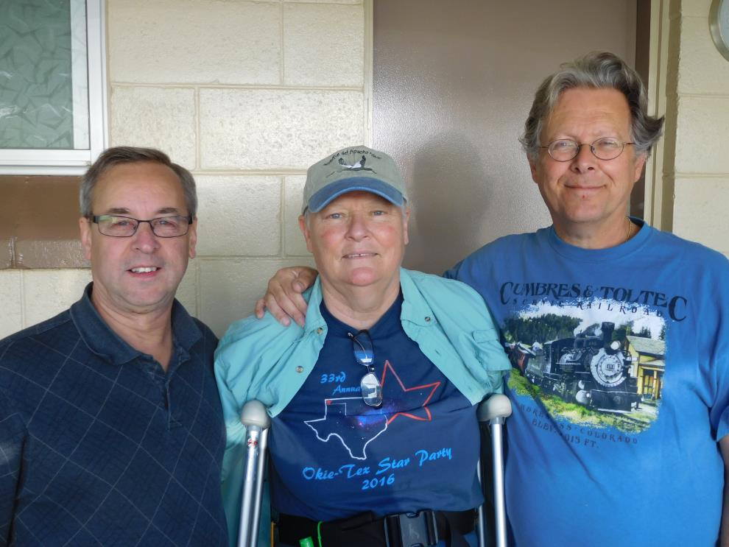
OzSky 2017

Slide 21
First things first
Why build a travel telescope?
  Have personal telescope at OzSky
  Have an air travel ready telescope for star parties
  Engineering/ craftsmanship challenge
  Fun… I enjoy designing and building telescopes
Can I buy it?
  Probably not

Slide 22
Primary goals for Trill
How do you ship the telescope? UPS, checked luggage, or carry on luggage?
  Answer: checked luggage.
  Advantage: This allowed larger mirror and heavier telescope, and reduced threat going through security.
  Disadvantage: Scope will undergo rougher treatment.
How do you package the telescope? Examples – box, crate, or luggage?
  Answer: 2 wheeled luggage.
  Advantage: This allows easy ground transport.

Slide 23
Ordered Goals for Trill
Telescope fits in suitcase (24”X15 ½”X8”)
Total weight under 50 lbs (24 kg) including suitcase for airline travel, 44 lbs (20 kg) for train travel (final is 44 lbs, 20 kg)
Largest mirror for size and weight limits
Eyepiece height under 66” (1.67 m)
Packed telescope almost indestructible
Mirror enclosed, stay with telescope
Setup/teardown time around 15 minutes

Slide 24
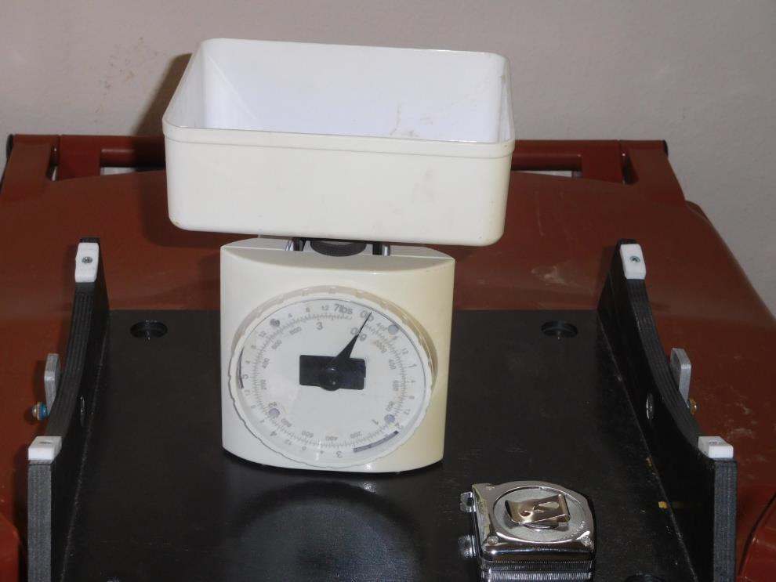
The most important tools in the toolbox

Slide 25
Trill’s Stored Size
Height (maximum 8” unexpanded)
  1” trusses on bottom of case
  ½” ground board
  ½” rocker box bottom
  ½” mirror box plywood bottom
  ¾” mirror cell and empty space above mirror
  1 ½” mirror
  3 x ½” upper cage plywood rings
  2 x ½” bearings
Total: 7 ¼”

Slide 26
Trill’s Stored Size
Width of mirror and rocker box (maximum 15 ½” )
  12” mirror
  ½” gap
  2 x ½” plywood sides
  1” for trusses
Total: 14 ½”
Width of secondary cage (maximum 15 ½”)
  12” mirror diameter
  13” inner ring diameter
  15” outer ring diameter
Total: 15”

Slide 27
Trill’s weight (finals, actual)
14 lbs 3 oz – 12” diameter 1 ½” thick mirror
4 lbs 5 oz – mirror box and cell
5 lbs 2 oz – trusses
3 lbs 4 oz – upper cage (includes focuser and secondary)
1 lbs 5 oz – bearings
4 lbs 8 oz – rocker box and base
7 lbs 0 oz – Suitcase
Total scope: 32 lbs 11 oz
Total package: 39 lbs 11 oz

Slide 28
High level design concepts (1)
Mirror box bottom drops to collimate, attaches solid for transport.
Mirror box fits within rocker box.
Bearings 1” radius too small. Need to add 3 lbs of rocks to front of mirror box.
Bearings only go to 10 degrees from horizon.
Trusses split in half. 23 ½” long. Friction fit.

Slide 29
High level design concepts (2)
1 ¼” lightweight helical Crayford HC-1.
Rigel Quickfinder red dot finder and protractors.
Eyepieces are: 24mm Panoptic, 12mm (2x Tele Vue barlow), 8mm (3x Tele Vue barlow).
Spider/ secondary holder: commercial Astrosystems.

Slide 30
Final stats
Mirror: 12” f 5, 1 ½” thick
Stored footprint: 15” x 16” x 7”
Weight – remove extra parts: 42.5 lbs (includes seat lift and coat)
Weight - heaviest: 47.5 lbs (includes seat lift and coat)
Eyepiece height at zenith: 58”
Setup is around 20 minutes

Slide 31
Final observations
Very stable and balance is good
Wind is somewhat problematical, due to lack of weight
Resistant to dewing (except secondary)
Collimation works well
Eyepieces work well

Slide 32
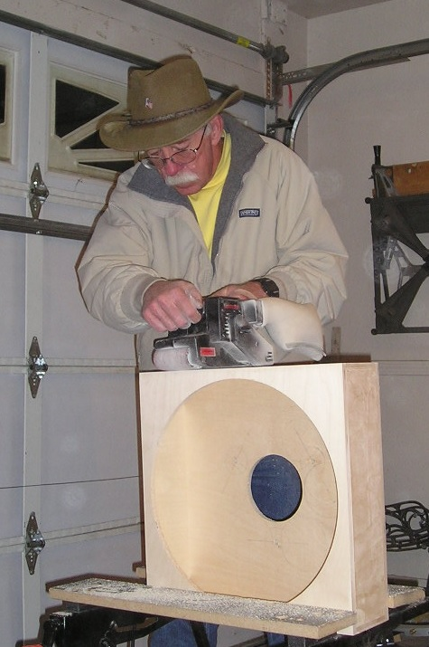
Let’s make a telescope!

Slide 33
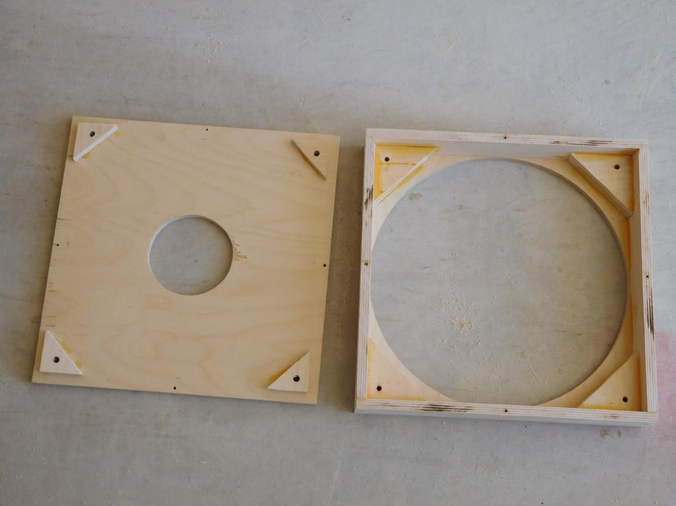
Mirror box

Slide 34
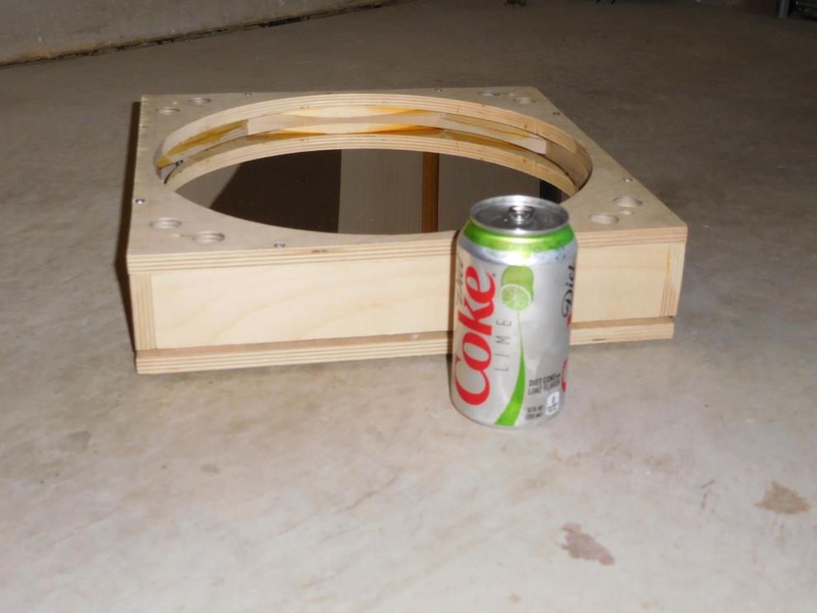
Mirror box

Slide 35
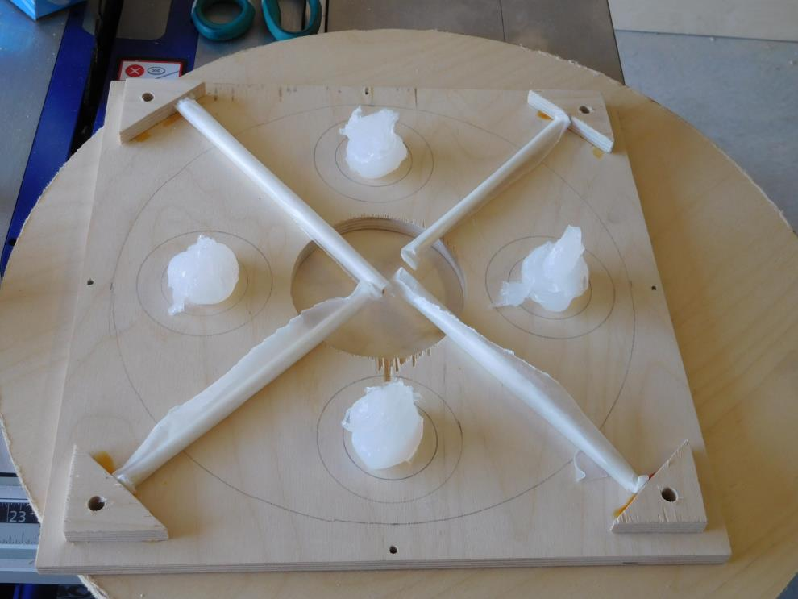
Mirror cell

Slide 36
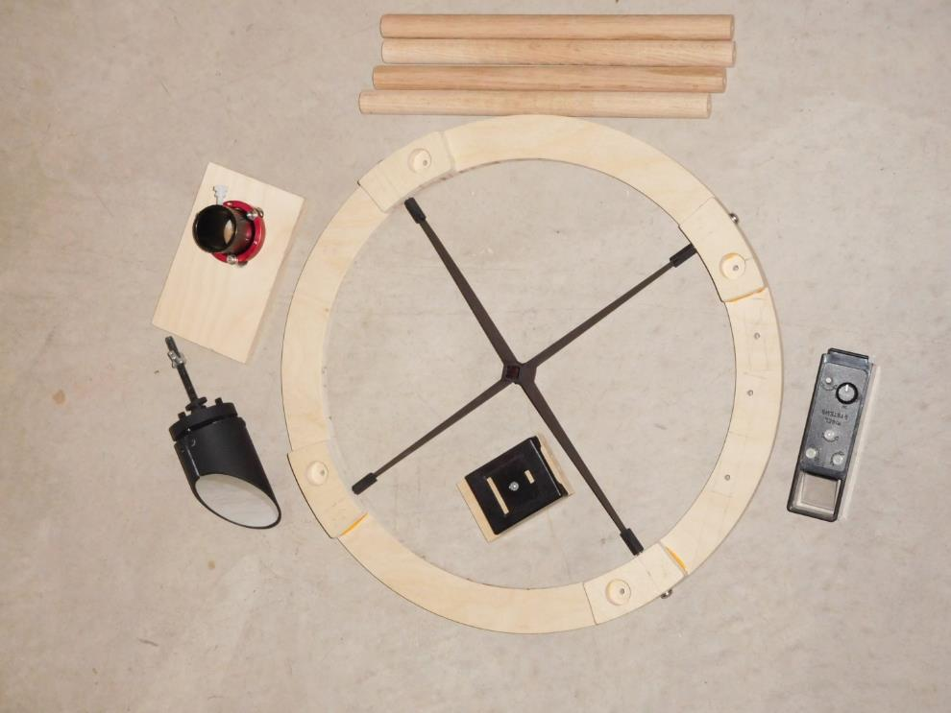
Upper cage parts

Slide 37
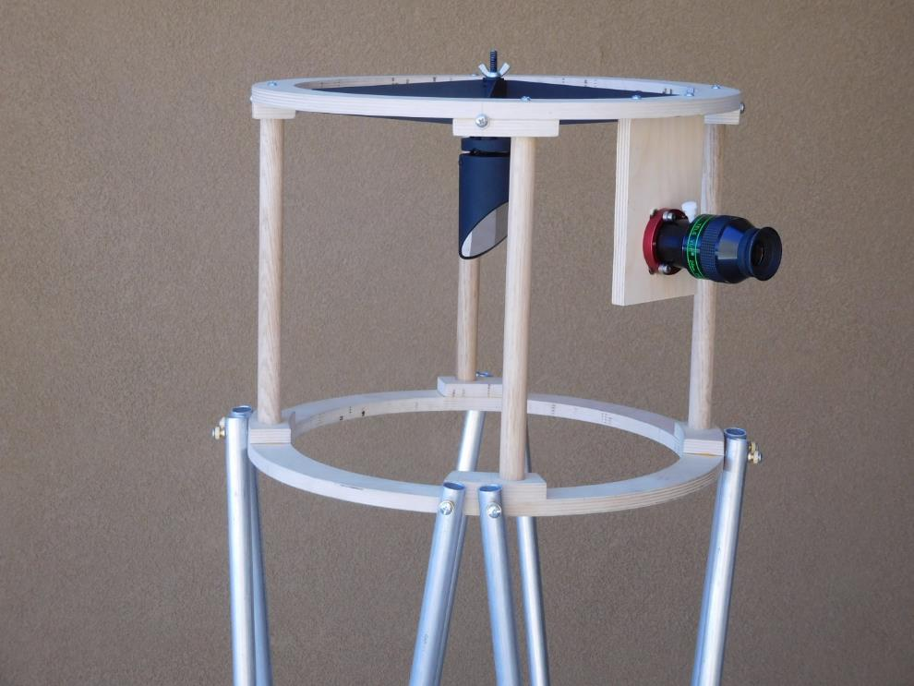
Upper cage complete

Slide 38
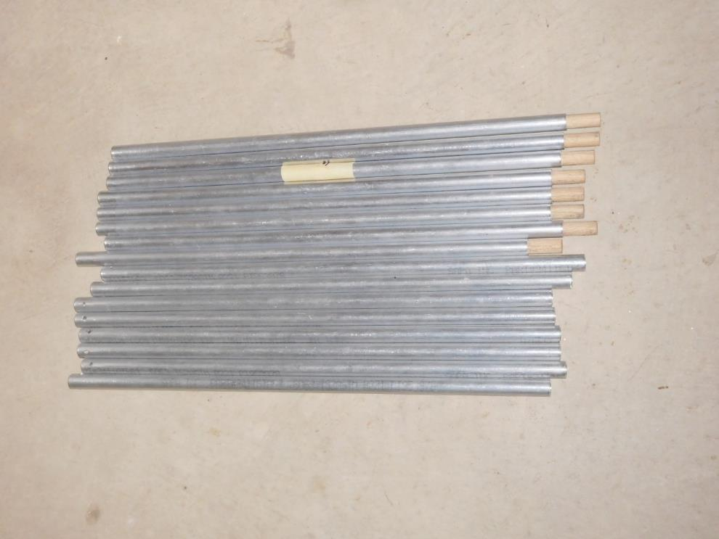
Trusses

Slide 39
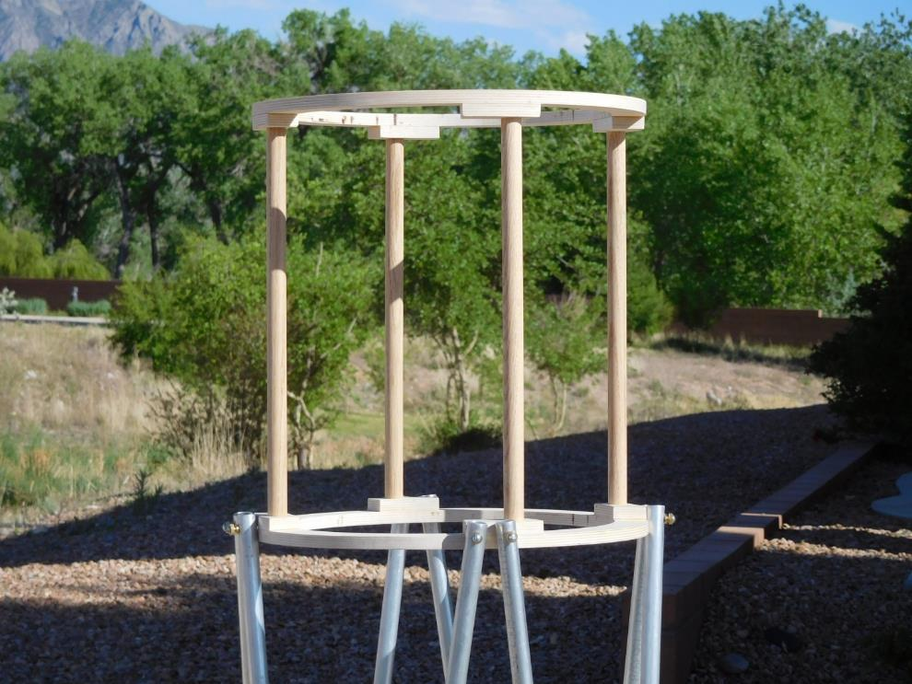
Upper attachment trusses

Slide 40
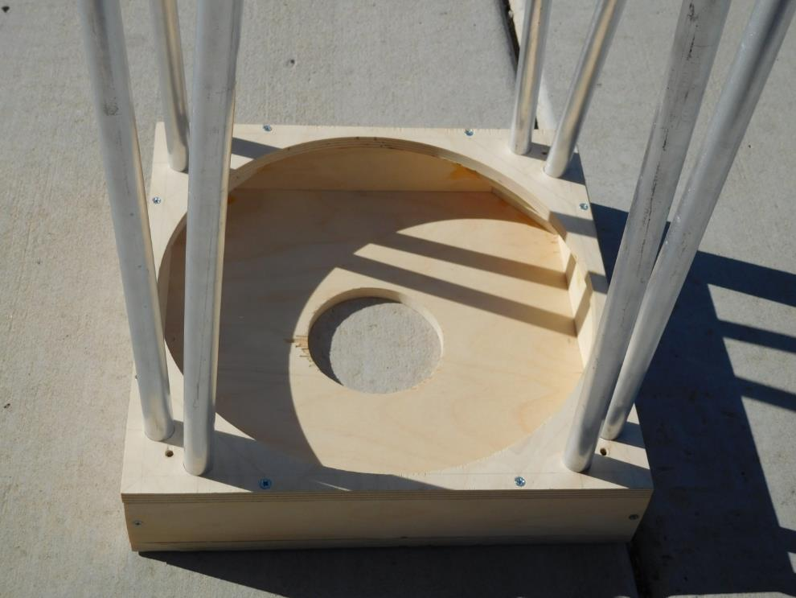
Lower attachment trusses

Slide 41
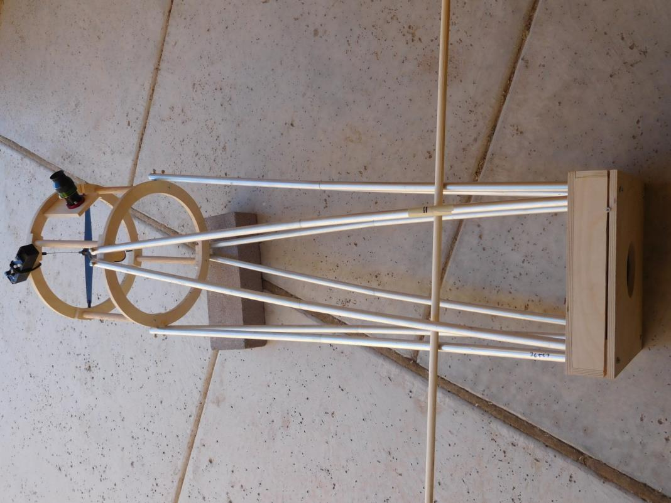
Find focus, cut trusses to length

Slide 42
Find the Center of Gravity
(Warning, math ahead)
Center of gravity (CG) ALWAYS equals center of rotation of the bearings.
Weight times distance above CG (secondary) equals weight times distance below (mirror box).
OK, I lied, ask me if you care about the math.
Basically, calculate the theoretical CG. Do the bearings fit in the suitcase?

Slide 43
Find the actual center of gravity

Slide 44
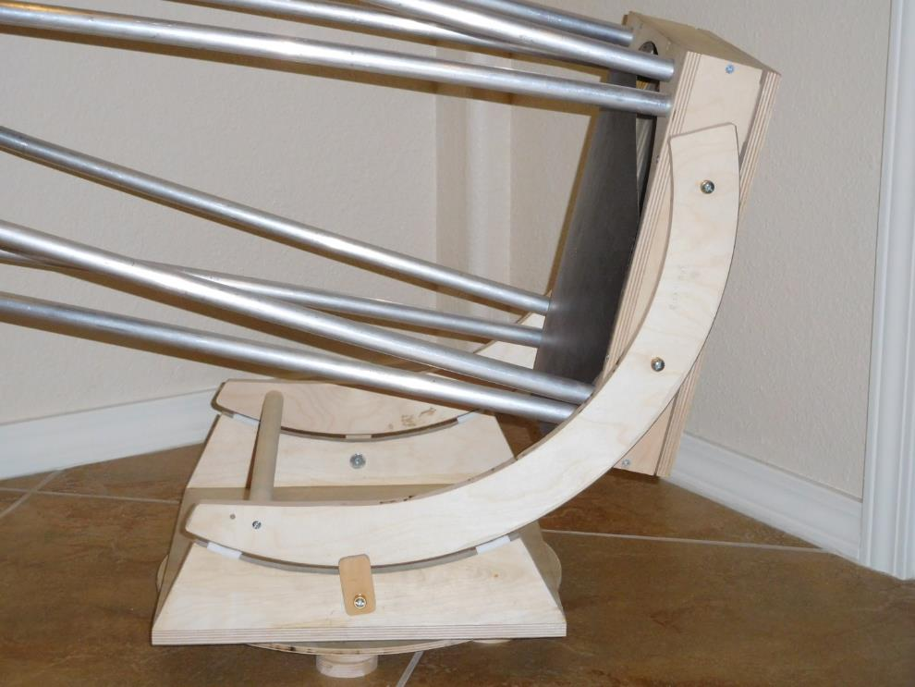
Center of bearings equal center of gravity

Slide 45
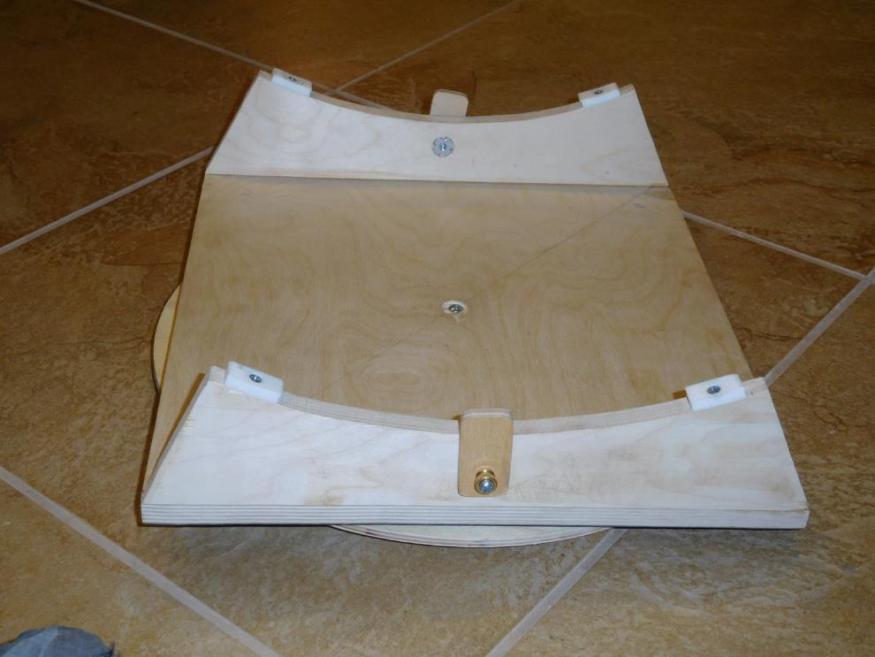
Rocker box

Slide 46
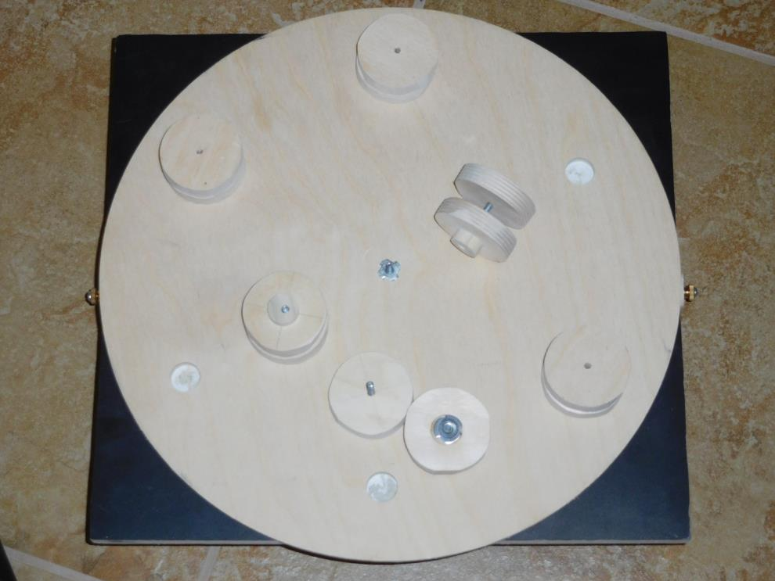
Ground board

Slide 47
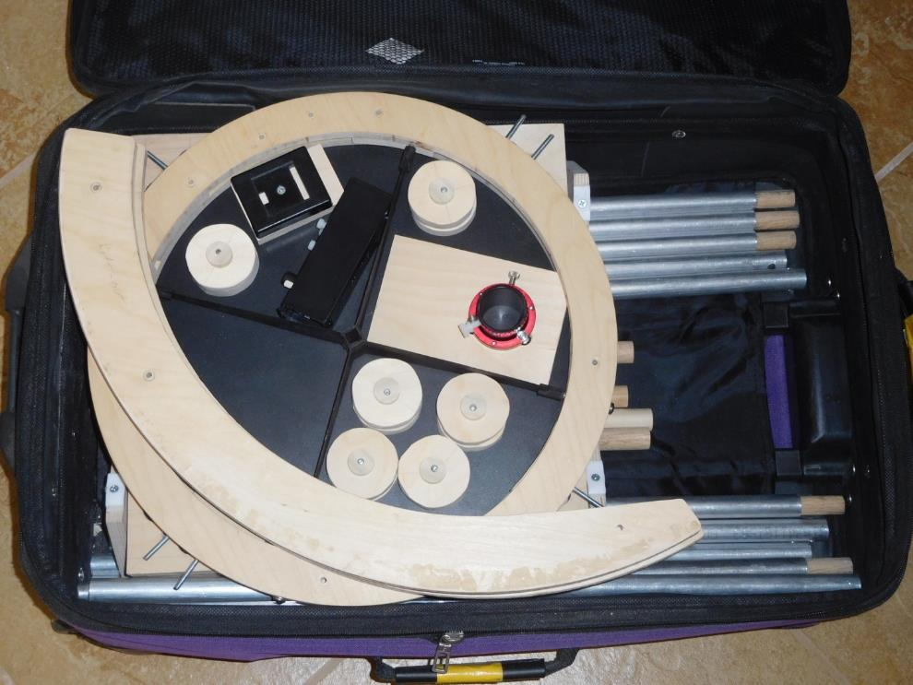
Bearings and stuff

Slide 48
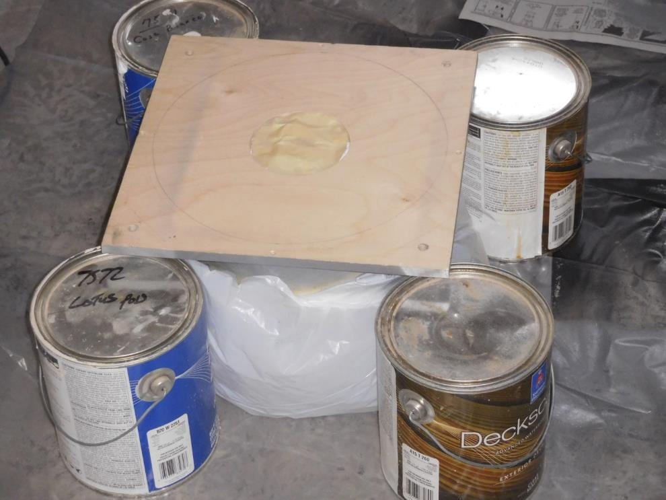
Painting mirror box bottom

Slide 49
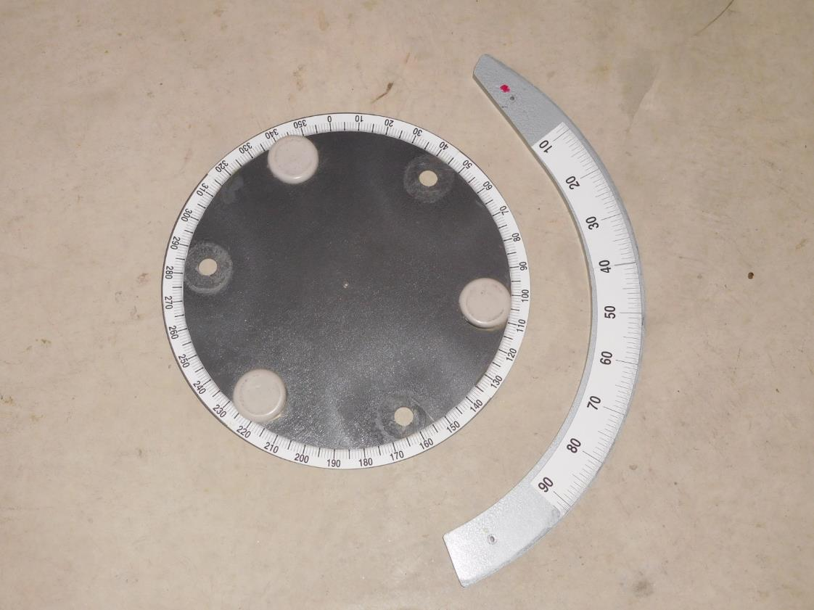
Protractors

Slide 50
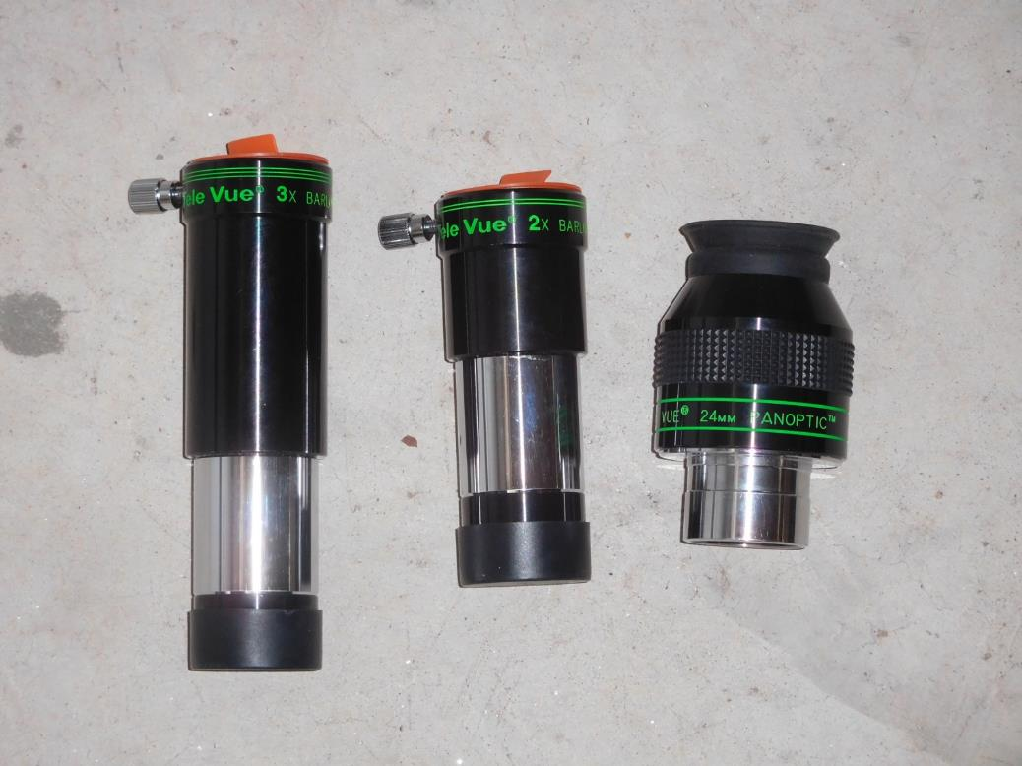
Eyepieces and filters

Slide 51
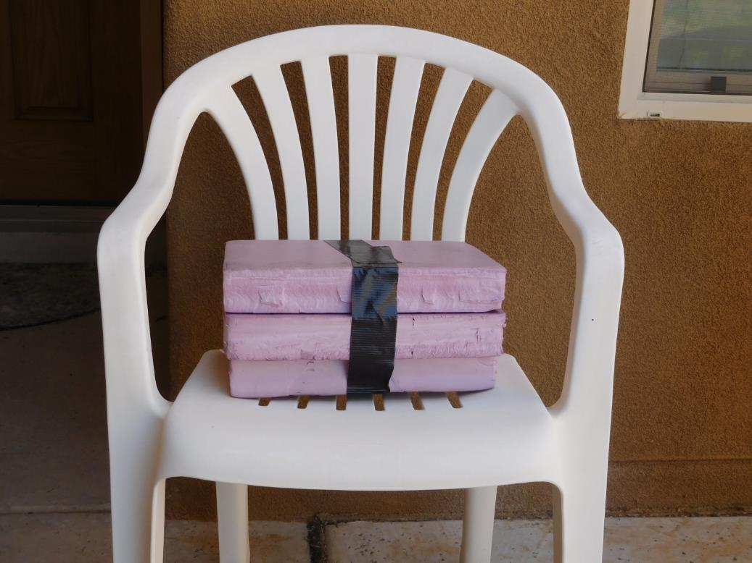
Suitcase spacers and a seat

Slide 52
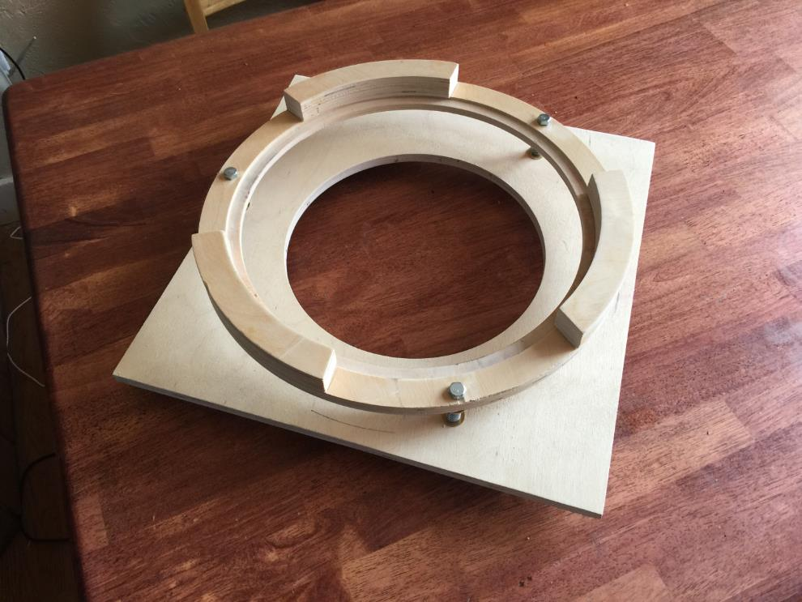
Don’t just use my ideas!
Dale Murray’s mirror cell

Slide 53
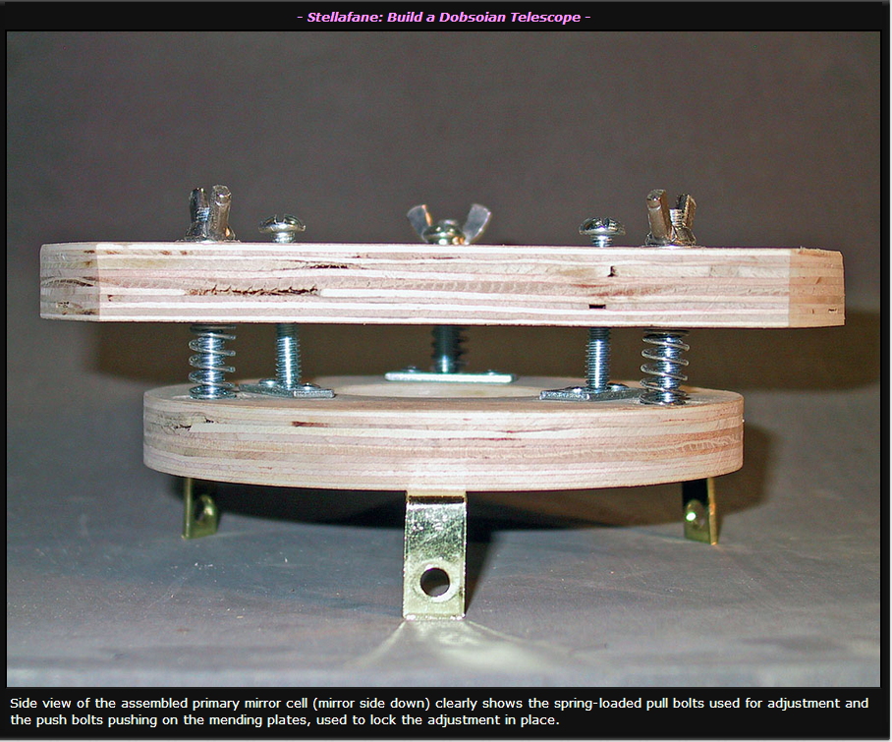
Mirror cell from Stellafane

Slide 54
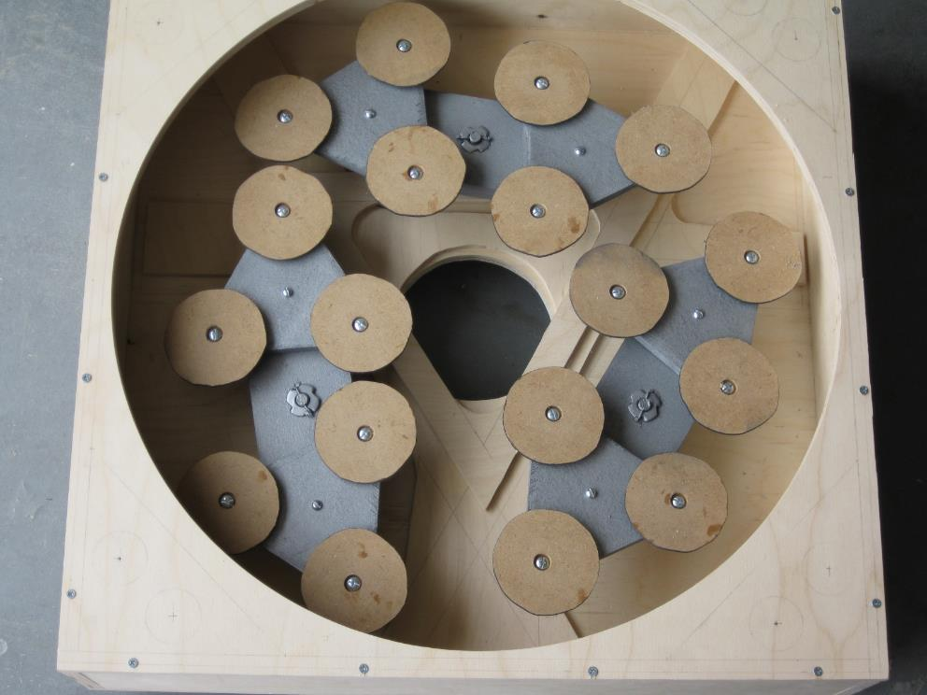
DS 4’s mirror cell

Slide 55
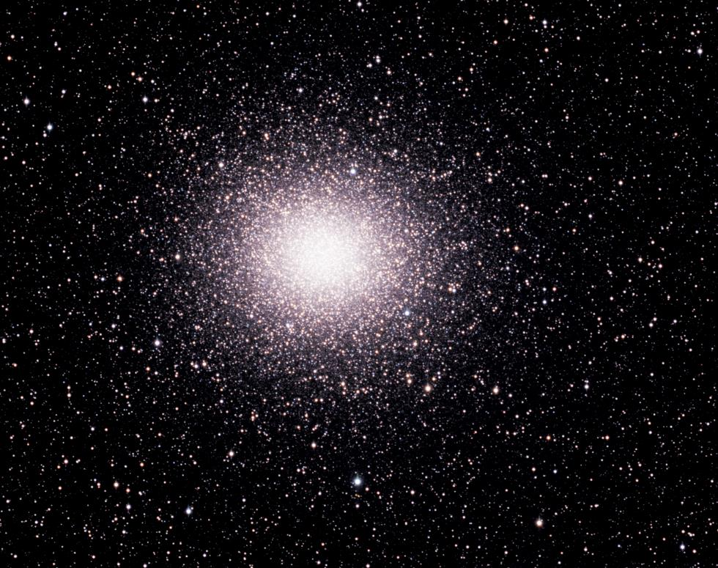
How did trill do?
Omega Centauri. “Oh my … Spectacular.” Lachlan MacDonald.

Slide 56
Fine out, disaster back
The scope survived fine flying to Australia, train to and from Coona.
Very nice taxi driver in Sydney drop tested the scope from 3 feet up. (Well, it actually fell out of a trailer.)
Only major damage was a trashed spider.
Mirror and mirror box are fine!
I am adding a 1” insulation layer above the secondary for airline travel.

Slide 57
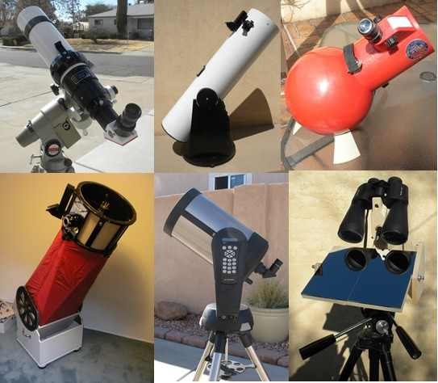
TAAS telescope loaner program

Slide 58
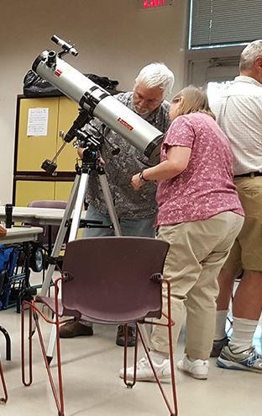
TAAS Amateur Telescope Making club

Slide 59
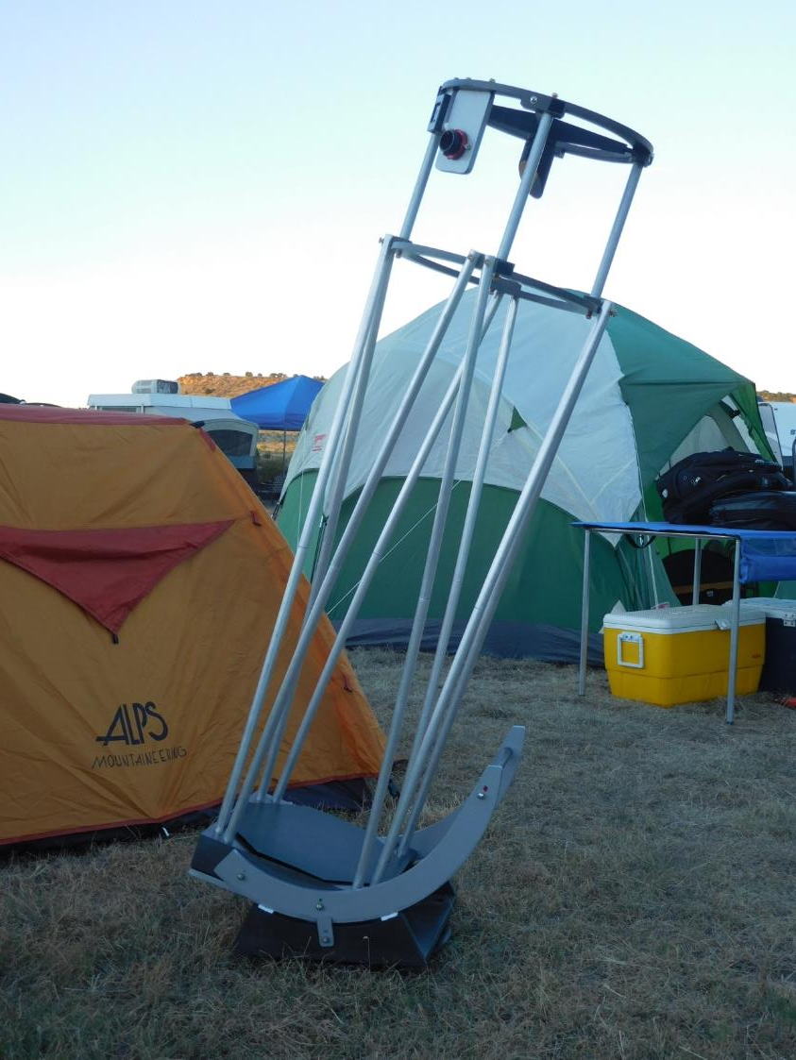

Slide 60
Deep Space Trill
Lets set up a telescope

Slide 61
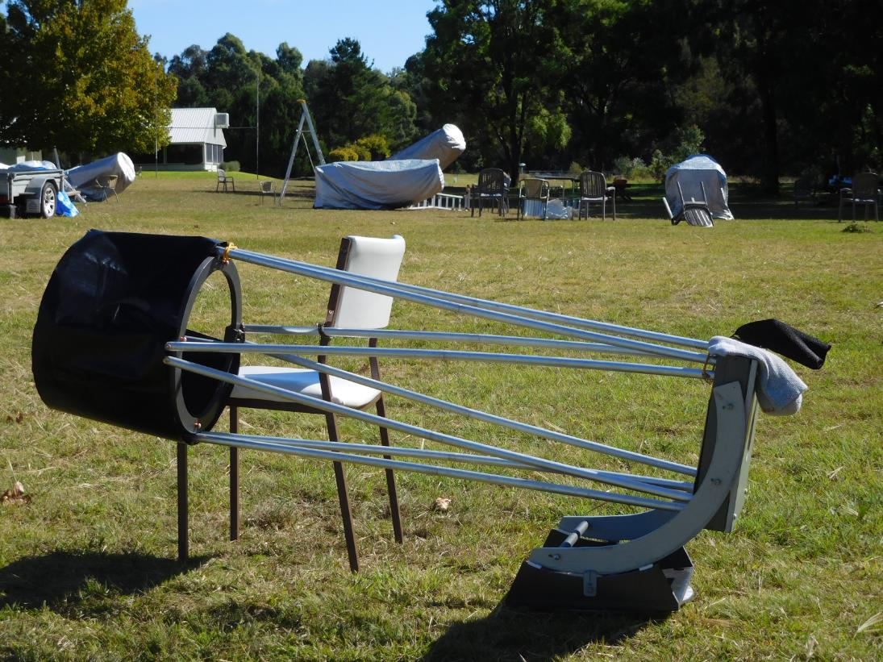
Deep Space Trill

